Slide 1
Healthy Learning, Healthy Lives Award Key Stage1-5
Quick Reference Guide
For more information and a breakdown of these criteria, go to www.healthylearningdoncaster.co.uk
Emotional Health and Wellbeing | Criteria 1 Policy The setting has an emotional health and wellbeing policy and a named emotional health and wellbeing lead | Criteria 2 Environment A positive environment which enhances emotional health and wellbeing of all in school. There are regular opportunities provided for children to access support | Criteria 3 Teaching and learning Education on understanding and talking about emotions is provided using a range of good quality resources that are appropriate with regard to the pupils’ age, ability, maturity and background, and reflect diversity. | Criteria 4 CPD/training The school is committed to staff CPD for emotional health and wellbeing, including safeguarding | Criteria 5 Partnerships The school has developed a whole service approach to supporting good emotional health and wellbeing with children and families. | Enhanced Criteria (Optional): You can apply for an Enhanced Award once you have gained your Healthy Learning, Healthy Lives Award.
Food, Drink & Oral Health | Criteria 1 Policy The school has a Food & Drinks Policy that includes oral health. | Criteria 2 Environment School meals are varied and balanced with consideration given to the needs and diversity of the pupils. The environment where food is eaten is conducive to positive behaviours. | Criteria 3 Teaching and learning Education on positive food and oral health behaviours is provided and there are consistent messages across subject areas | Criteria 4 CPD/training The school is committed to CPD/staff training in respect of the positive promotion of nutrition and oral health | Criteria 5 Partnerships The school has developed a whole service approach to encouraging and supporting a positive relationship with food and good oral health with children and families | Enhanced Criteria (Optional): You can apply for an Enhanced Award once you have gained your Healthy Learning, Healthy Lives Award.
Physical Activity | Criteria 1 Policy The school has a physical activity policy which acknowledges and recognises opportunities for physical activity across the whole school. | Criteria 2 Environment The school environment is conducive to safe physical activity and active travel is encouraged and facilitated. There are a range of physical activity, sport and play opportunities on offer such as before, during and after school clubs, activities at break and lunch times. | Criteria 3 Teaching and learning The school curriculum includes physical activity and incorporates learning outcomes which are monitored and evaluated to ensure quality of teaching, opportunities and learning | Criteria 4 CPD/training There is a commitment from the school to increase confidence, knowledge and skills of ALL staff in teaching PE and Sport. | Criteria 5 Partnerships The school has partnerships and engages with and provides opportunities for engagement with parents/carers, the local community, external agencies and volunteers. | Enhanced Criteria (Optional): You can apply for an Enhanced Award once you have gained your Healthy Learning, Healthy Lives Award.
PSHE | Criteria 1 Policy There is a PSHE policy or equivalent in place which clearly details the school’s approach, including but not limited to statutory RSHE. | Criteria 2 Environment The planned PSHE programme has a whole school approach with the entitlement of RSE for all learners is secured through planned provision across the whole age range. . | Criteria 3 Teaching and learning PSHE is taught through a variety of methods and is supported by a range of good quality resources that are appropriate with regard to the pupils’ age, ability, maturity and background, and reflect diversity | Criteria 4 CPD/training PSHE is delivered by staff who are well trained to deliver the subject and have the knowledge, confidence and skills to deal with subject matter that can be sensitive and personal | Criteria 5 Partnerships PSHE is seen as a partnership between school and home and there are effective measures to inform parents/carers, involve them in dialogue and consultation, and support them in continuing the learning on these issues with their children at home | Enhanced Criteria (Optional): You can apply for an Enhanced Award once you have gained your Healthy Learning, Healthy Lives Award.

Slide 2
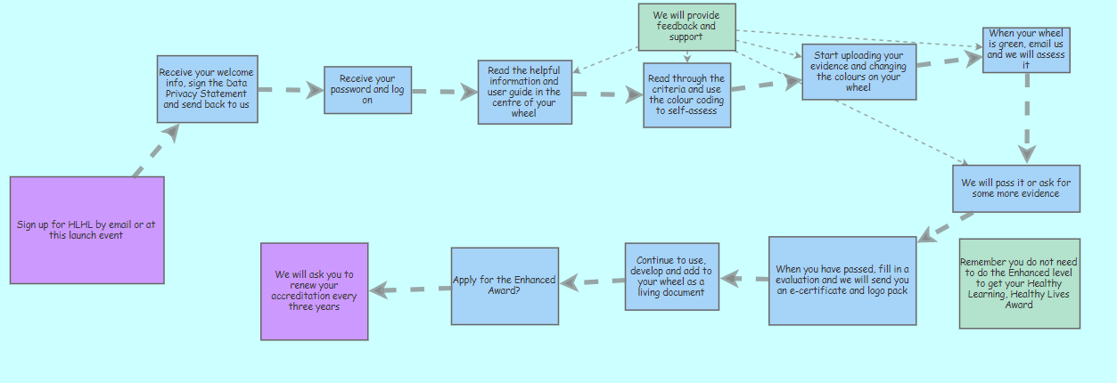
HLHL Accreditation Process
www.healthylearningdoncaster.co.uk
healthylearning@doncaster.gov.uk

